Slide 1

CypressXM Business Card Builder
BY:
Steven Xiong
Andrew Wright
Teresia Ramirez
Jason Phillips
Roberto Ochoa-Sanchez

Slide 2
1. Project Overview
Current Presenter:
Jason T. Phillips Jr.
•Client:Adam Waring
•Title: CEO
•Client’s business: Cypress Information Services LLC.
cypressresume.com
Website that builds resumes.
Cover letters and reference sheets.

Slide 3
1. Project Overview
Current Presenter:
Jason T. Phillips Jr.
•Client’s “problem” to be solved: Adam wants to provide his users an additional service which allows them to create a business card.
•A brief description of the problem: The site doesn’t provide such a tool and Adam believes that it would be beneficial to the users if they were able to create a business card alongside with the other documents his site provides.
•The proposed solution: Create a tool that would allow users to easily create a business card.

Slide 4
2. Requirements
Current Presenter:
Jason T. Phillips Jr.
Users can:
Select from a variety of card templates (12).
Select from a variety of logos (24).
Choose a color scheme (5).
Choose a color from a unique color wheel.
Preview changes live.
Edit the information on the card.
Download and Email the card.

Slide 5
3. Design
Current Presenter:
Roberto Ochoa-Sanchez
Consists of 2 web pages, with the 1st page containing:
A clickable color wheel consisting of 36 colors with 5 unique color schemes
12 different, selectable business card templates
24 logo options to customize the chosen template
A preview window demonstrating the users choices in real time
A submit button that transfers the user’s choices to the following page

Slide 6
3. Design
Current Presenter:
Roberto Ochoa-Sanchez
The 2nd page contains:
Text fields for the user to enter information such as a name, business position/location, and contact information
Buttons that swap each individual fields text color between white and black
An unemployed/employed selection that removes certain fields
A preview window of the business card created in the 1st page that updates in real time as the user types into the text fields
A download button that saves the card as a PNG file
A Send-By-Email button that sends the card as an attachment to the entered address

Slide 7
4. Implementation
Current Presenter:
Roberto Ochoa-Sanchez
1st website iteration:
Preliminary, static JPEG card templates on 1st page.
Selectable color wheel with the color schemes that didn’t change the static JPEG templates
Working live preview window with text fields on 2nd page
2nd website iteration:
SVG format card templates added that can be customized by color wheel
Download and Send-To-Email button functionality on 2nd page
Color scheme combinations limited corresponding to selected card

Slide 8
4. Implementation
Current Presenter:
Roberto Ochoa-Sanchez
3rd website iteration:
Designed card template now transferable from 1st page to 2nd page
Unemployed/Employed selection now correctly removing/adding text fields
Added implementation for user to choose a logo, but no actual logos yet
4th website iteration:
Redesigned the 1st page to suit the flow of how a user would design the card
Added 24 logo options that the user can select to have on their card
Added text field limitations unique to each card that prevent users from writing overflowing text to undesired areas of the card

Slide 9
4. Implementation
Current Presenter:
Roberto Ochoa-Sanchez
Programming languages used:
HTML, Javascript, PHP, CSS
In total, we created 36 files totalling roughly 2800 lines of code

Slide 10
5. Testing
Current Presenter:
Steven Xiong
•Tested using Selenium on web browser’s Firefox & Chrome
•The overall plan was to first test the functionality of the core components and see if they worked, after that we tested the integration between these core components

Slide 11
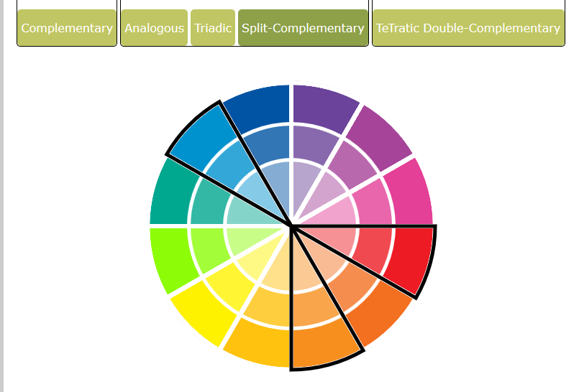
5. Testing
Current Presenter:
Steven Xiong
Core component testing
Live card preview
Card Templates
Color Wheel

Slide 12






5. Testing
Current Presenter:
Steven Xiong

Slide 13
6. Demo
Current Presenter:
Andrew Wright
•Demonstrate your product in real-time.

Slide 14
7. Lessons Learned
Current Presenter:
Teresa Ramirez
Challenges & how they were overcome:
New technologies/Languages
Time for meetings
Things Learned:
New technologies/Languages
Working with a client
SCRUM

Slide 15
8. Conclusion
Current Presenter:
Teresa Ramirez
Client’s Feedback:
Positive (Minor improvements)
Sprint 05 & things to be improved:
Add Logos that are free for commercial use
Update business card web page layout
Wish List Items:
ADA Compliant
Mobile Support

